Slide 1
Quantum Gradient Parameter shift method
2019
5/6/2021

Slide 2
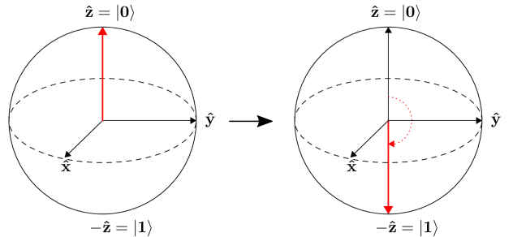

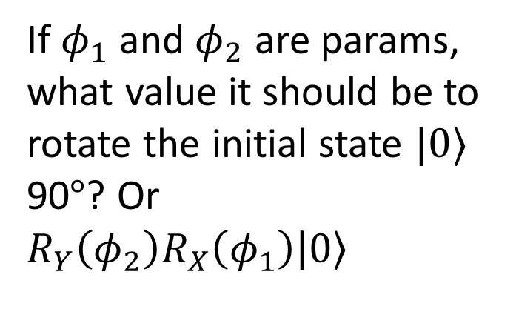
0. Problem: Rotation gate
If $φ_{1}$ and $φ_{2}$ are params, what value it should be to rotate the initial state $|0⟩$ 90$°$? Or $R_{Y}\left(φ_{2}\right)R_{X}\left(φ_{1}\right)\left|0\right\rangle$

Slide 3
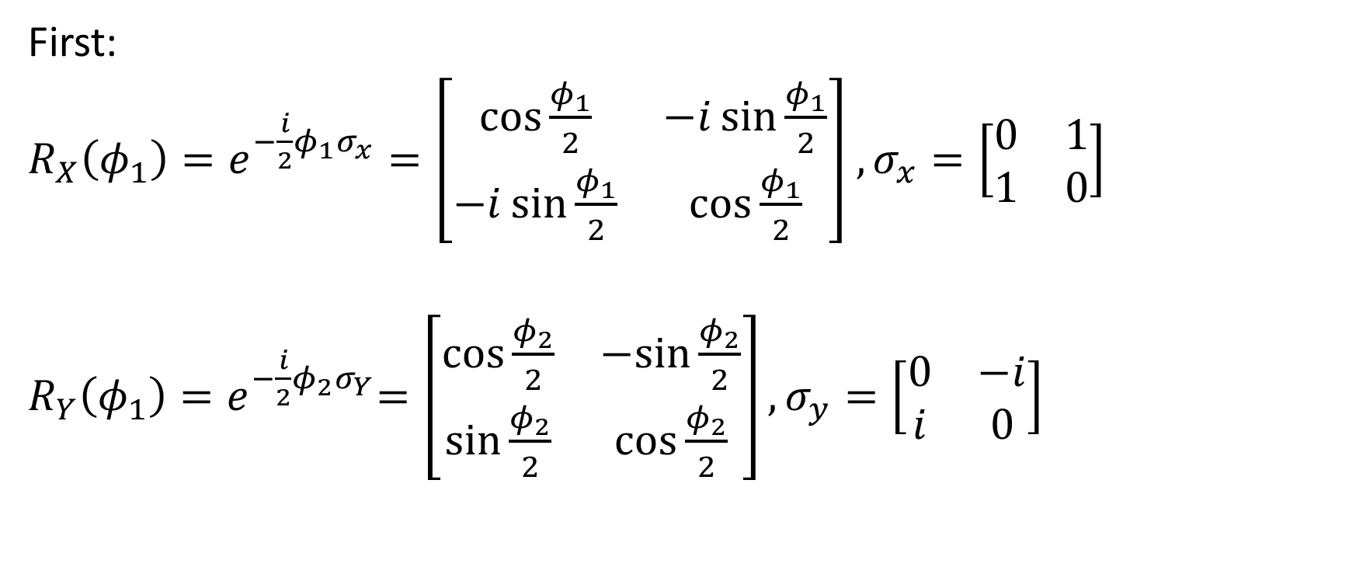
Rotation gate
First:
$R_{X}\left(φ_{1}\right)=e^{−\frac{i}{2}φ_{1}σ_{x}}=\left[\begin{matrix}\cos{\frac{φ_{1}}{2}} & −i\sin{\frac{φ_{1}}{2}} \\ −i\sin{\frac{φ_{1}}{2}} & \cos{\frac{φ_{1}}{2}}\end{matrix}\right]$ $,σ_{x}=\left[\begin{matrix}0 & 1 \\ 1 & 0\end{matrix}\right]$
$R_{Y}\left(φ_{1}\right){=e}^{−\frac{i}{2}φ_{2}σ_{Y}}=\left[\begin{matrix}\cos{\frac{φ_{2}}{2}} & −sin{\frac{φ_{2}}{2}} \\ \sin{\frac{φ_{2}}{2}} & \cos{\frac{φ_{2}}{2}}\end{matrix}\right],σ_{y}=\left[\begin{matrix}0 & −i \\ i & 0\end{matrix}\right]$

Slide 4
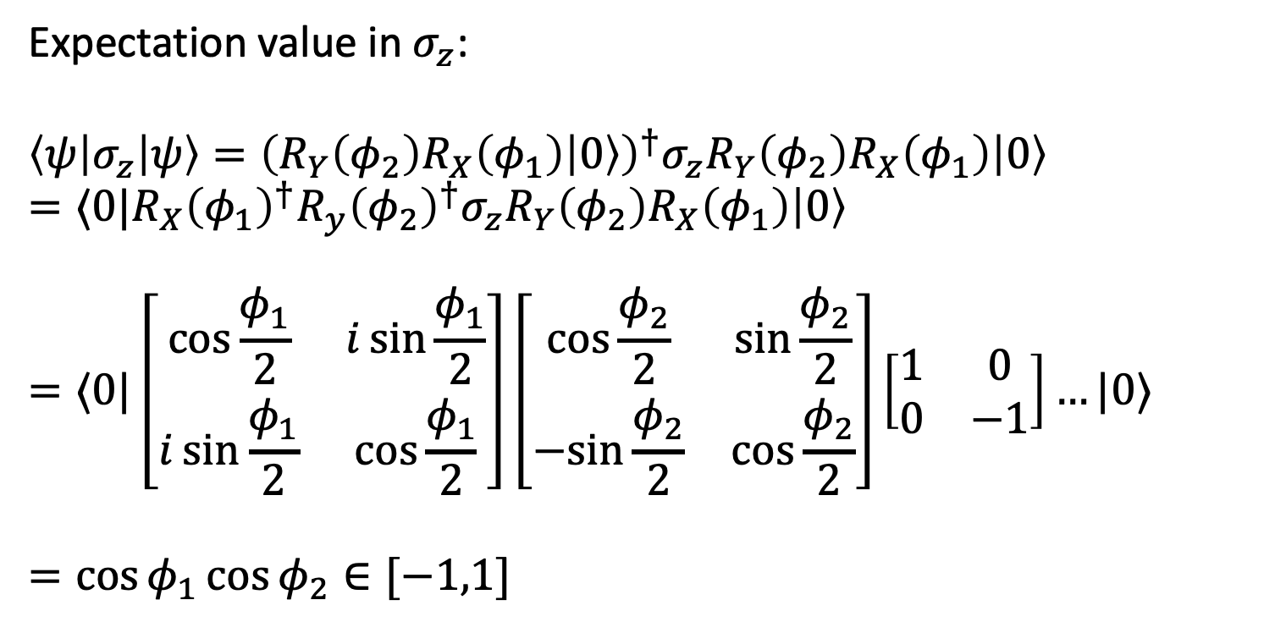
Rotation gate
Expectation value in $σ_{z}$:
$$\left\langle ψ\left|σ_{z}\right|ψ\right\rangle ={\left(R_{Y}\left(φ_{2}\right)R_{X}\left(φ_{1}\right)\left|0\right\rangle \right)}^{†}σ_{z}R_{Y}\left(φ_{2}\right)R_{X}\left(φ_{1}\right)\left|0\right\rangle$$
$$=⟨0|R_{X}{\left(φ_{1}\right)}^{†}R_{y}{\left(φ_{2}\right)}^{†}σ_{z}R_{Y}\left(φ_{2}\right)R_{X}\left(φ_{1}\right)\left|0\right\rangle$$
$$=⟨0|\left[\begin{matrix}\cos{\frac{φ_{1}}{2}} & i\sin{\frac{φ_{1}}{2}} \\ i\sin{\frac{φ_{1}}{2}} & \cos{\frac{φ_{1}}{2}}\end{matrix}\right]\left[\begin{matrix}\cos{\frac{φ_{2}}{2}} & \sin{\frac{φ_{2}}{2}} \\ −sin{\frac{φ_{2}}{2}} & \cos{\frac{φ_{2}}{2}}\end{matrix}\right]\left[\begin{matrix}1 & 0 \\ 0 & −1\end{matrix}\right]…|0⟩$$
$$=\cos{φ_{1}}\cos{φ_{2}∈[−1,1]}$$

Slide 5

Rotation gate
We want our state rotate 90 degree so $\cos{φ_{1}}\cos{φ_{2}}=−1$

Slide 6
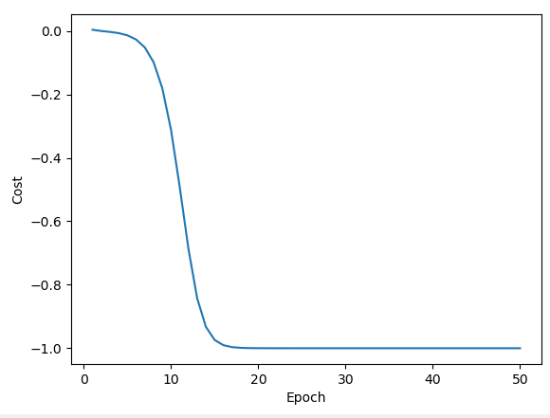
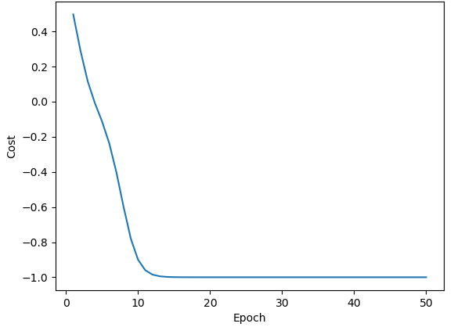


Experiments
With normal initialize for the pair $(φ_{1},φ_{2})$, 100 epoch, 0.4 learning rate, optimizer: GD, gradient by parameter – shift rule.
Init $φ$: [ 1.43609915 -1.48030143]
Init $φ$: [-0.51976105 0.66569928]
Solution: [ 2.83369713e-09 -3.14159265e+00]
Solution: [-4.44548300e-10 3.14159265e+00]

Slide 7

Basic definition
Variational quantum algorithm (VQA) is a quantum-classical hybrid scheme
Update $θ$
Quantum part
Classical part
Input
Cost value

Slide 8
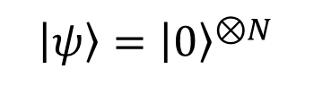
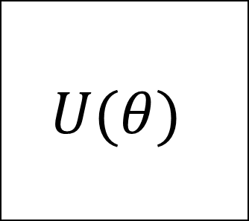
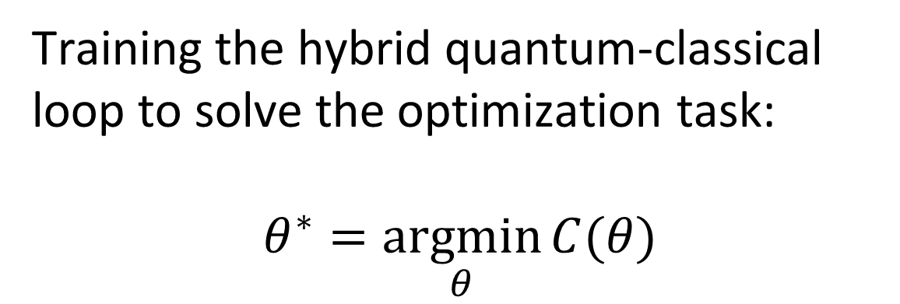
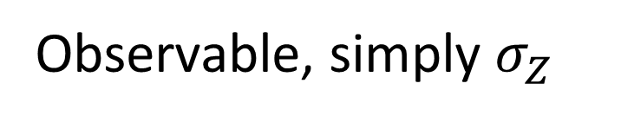

Basic definition
$$U(θ)$$
$$C\left(θ\right)≔⟨ψ\left|U^{†}\hat{B}U\right|ψ⟩$$
$\left|ψ\right\rangle ={\left|0\right\rangle }^{⊗N}$
Measure
Training the hybrid quantum-classical loop to solve the optimization task:
$$θ^{∗}=\underset{θ}{argmin}{C(θ)}$$
Observable, simply $σ_{Z}$

Slide 9
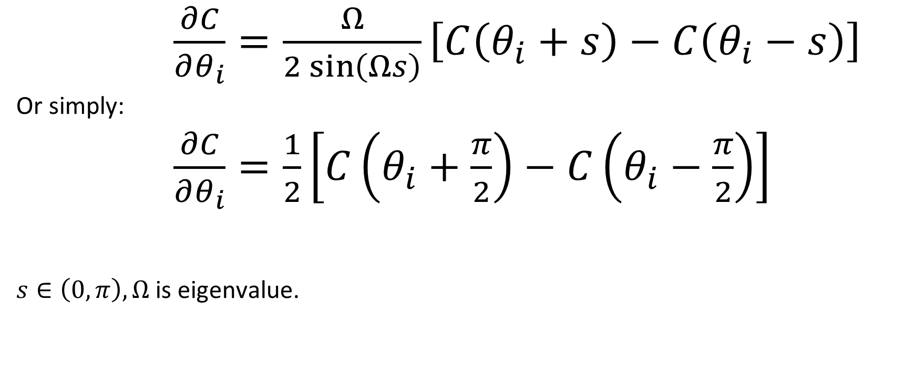


1. Parameter-shift rule
$\frac{∂C}{∂θ_{i}}=\frac{Ω}{2\sin\left(Ωs\right)}\left[C\left(θ_{i}+s\right)−C\left(θ_{i}−s\right)\right]$
Or simply:
$\frac{∂C}{∂θ_{i}}=\frac{1}{2}\left[C\left(θ_{i}+\frac{π}{2}\right)−C\left(θ_{i}−\frac{π}{2}\right)\right]$
$s∈\left(0,π\right),Ω$ is eigenvalue.
$$R_{Y}(θ)$$
$$λ=\{−1,1\}$$
Mitarai et al. (2018), and extended in Schuld et al. (2018)

Slide 10
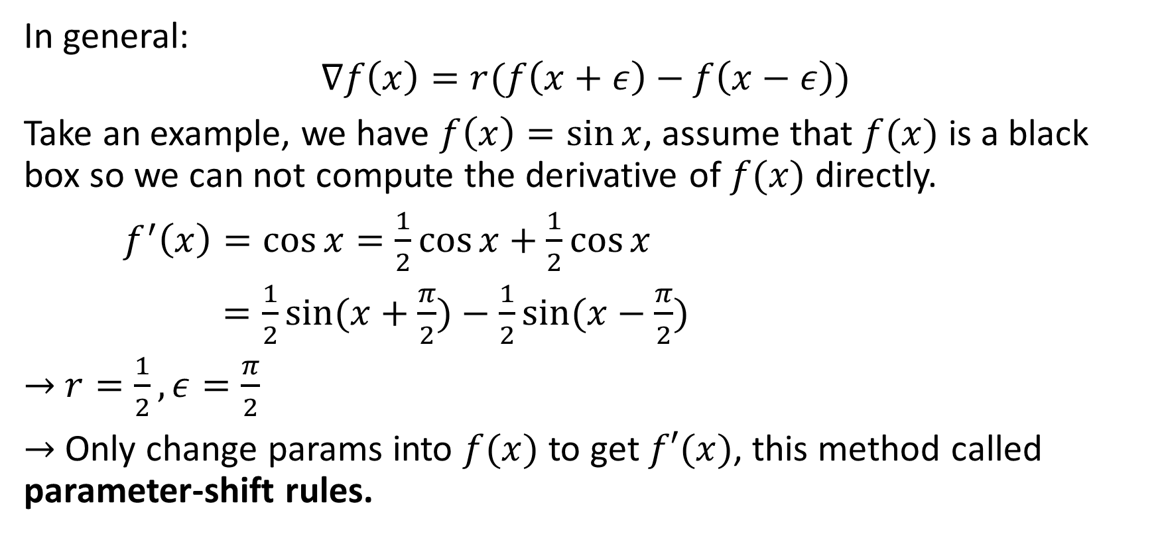
Examples
In general:
$$∇f\left(x\right)=r(f\left(x+ε\right)−f\left(x−ε\right))$$
Take an example, we have $f\left(x\right)=\sin{x}$, assume that $f(x)$ is a black box so we can not compute the derivative of $f(x)$ directly.
$f^{′}\left(x\right)=\cos{x=\frac{1}{2}\cos{x+\frac{1}{2}\cos{x}}}$
$=\frac{1}{2}\sin{(x+\frac{π}{2})}−\frac{1}{2}sin⁡(x−\frac{π}{2})$
$→$ $r=\frac{1}{2},ε=\frac{π}{2}$
$→$ Only change params into $f(x)$ to get $f′(x)$, this method called parameter-shift rules.

Slide 11
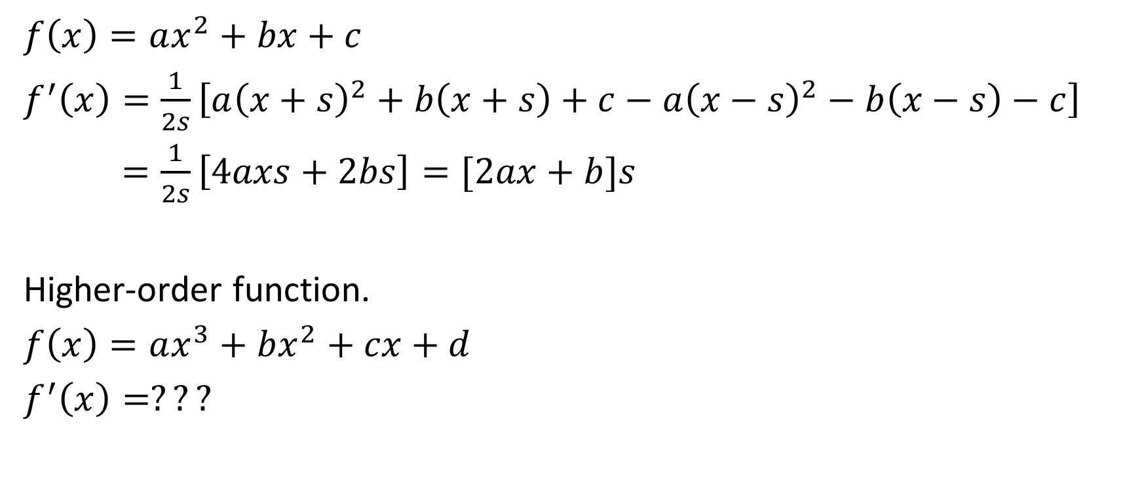
Examples
$f\left(x\right)=ax^{2}+bx+c$
$f^{′}\left(x\right)=\frac{1}{2s}\left[a{\left(x+s\right)}^{2}+b\left(x+s\right)+c−a{\left(x−s\right)}^{2}−b\left(x−s\right)−c\right]$
$=\frac{1}{2s}\left[4axs+2bs\right]=[2ax+b]s$
Higher-order function.
$f\left(x\right)=ax^{3}+bx^{2}+cx+d$
$f^{′}\left(x\right)=???$

Slide 12



1. Four – term parameter-shift rule
$\frac{∂C}{∂θ_{i}}=d_{1}\left[C\left(θ_{i}+s_{1}\right)−C\left(θ_{i}−s_{1}\right)\right]−d_{2}\left[C\left(θ_{i}+s_{2}\right)−C\left(θ_{i}−s_{2}\right)\right]$
$$R_{Y}(θ)$$
$$λ=\{−1,0,1\}$$
Kottmann (2021)

Slide 13
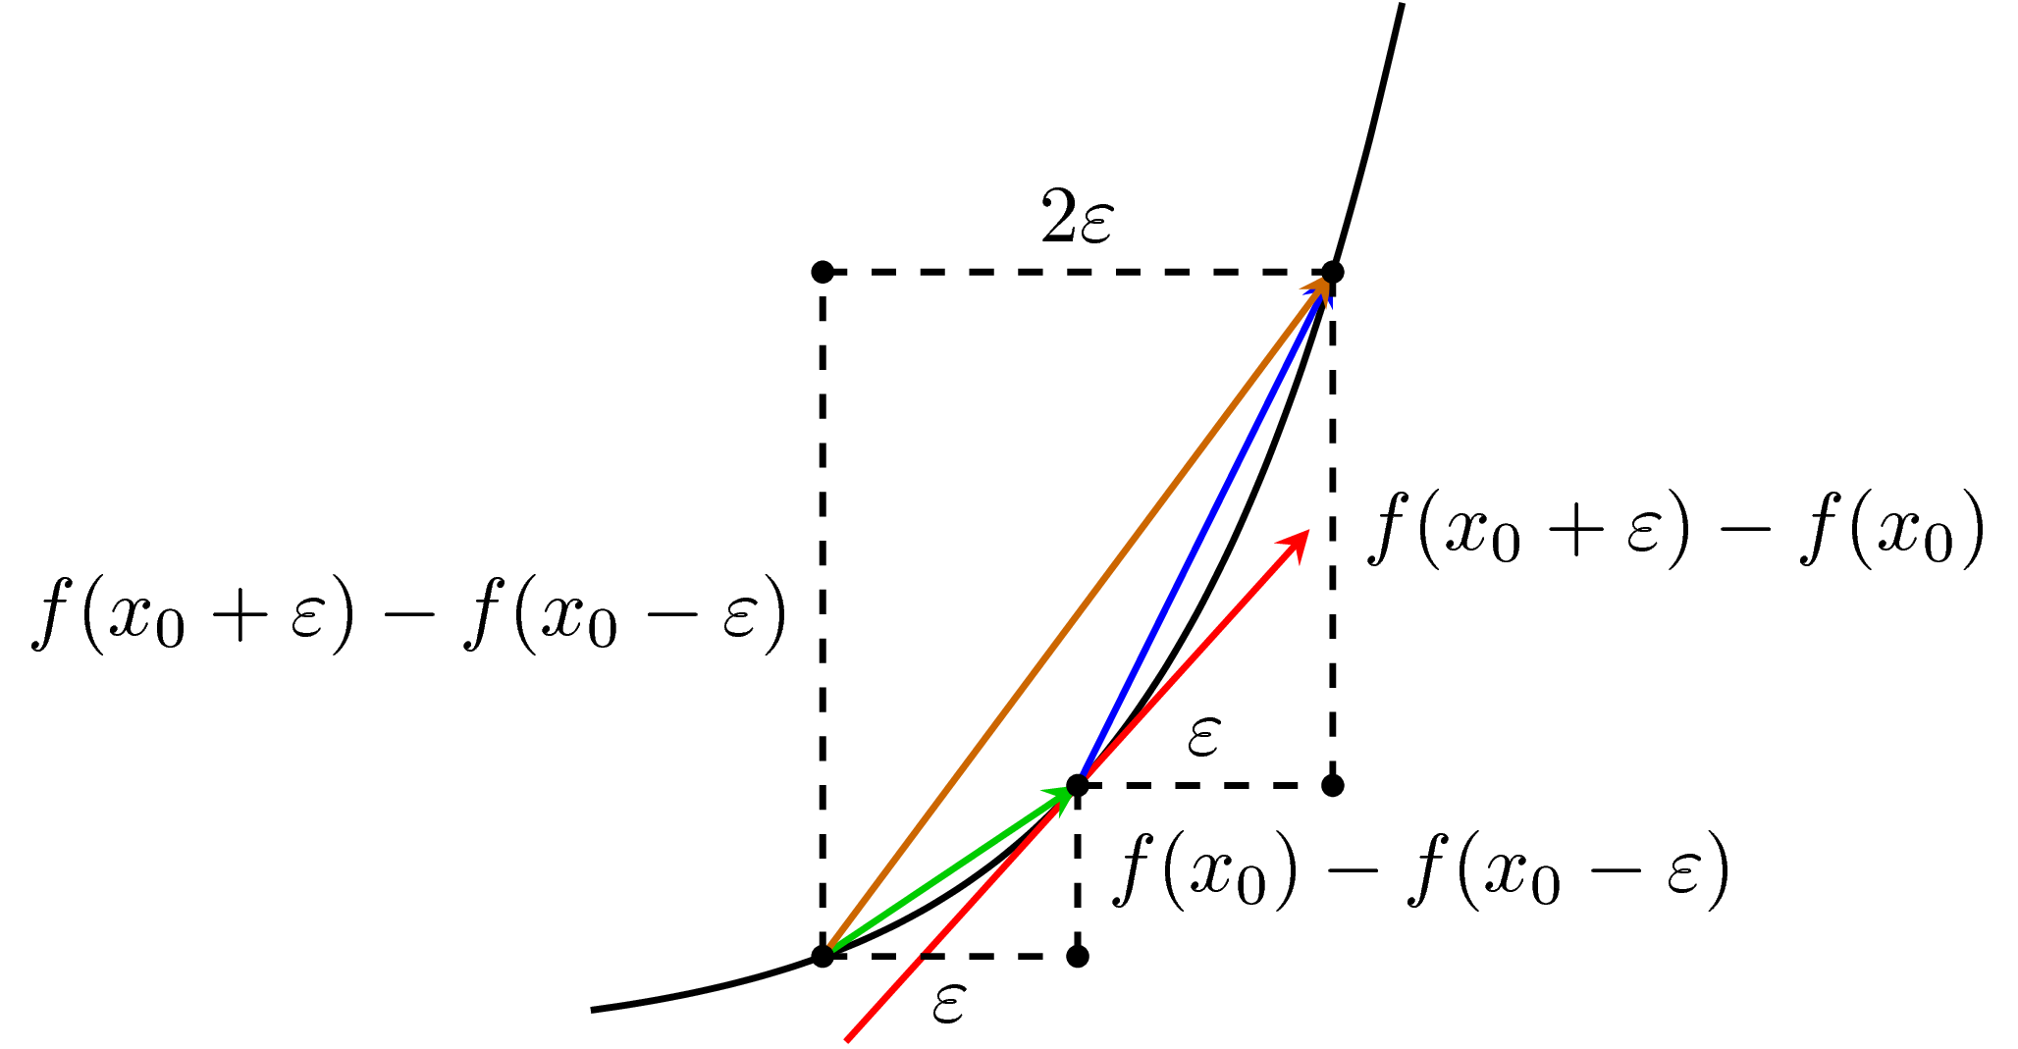
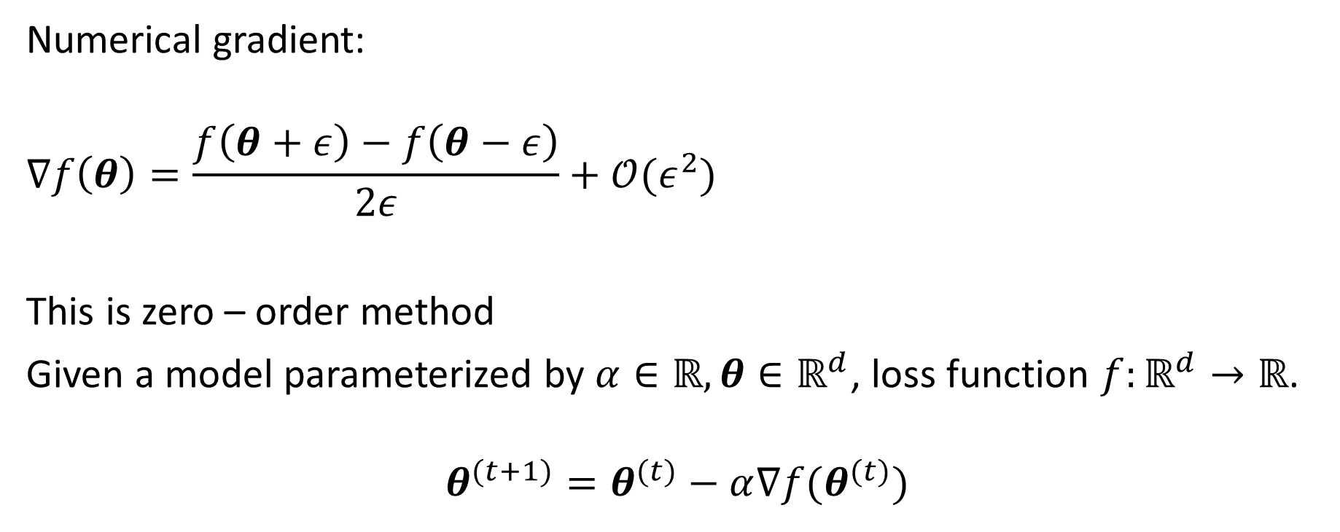

1. Gradient descent
Numerical gradient:
$$∇f\left(θ\right)=\frac{f\left(θ+ε\right)−f\left(θ−ε\right)}{2ε}+𝒪(ε^{2})$$
This is zero – order method
Given a model parameterized by $α∈ℝ,θ∈ℝ^{d}$, loss function $f:ℝ^{d}→ℝ$.
$$θ^{(t+1)}=θ^{(t)}−α∇f(θ^{(t)})$$

Slide 14
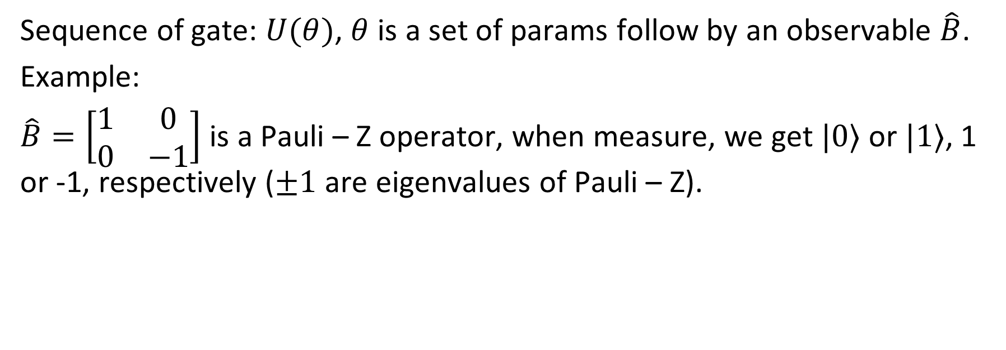

2. Notation
Sequence of gate: $U(θ)$, $θ$ is a set of params follow by an observable $\hat{B}$.
Example:
$\hat{B}=\left[\begin{matrix}1 & 0 \\ 0 & −1\end{matrix}\right]$ is a Pauli – Z operator, when measure, we get $|0⟩$ or $|1⟩$, 1 or -1, respectively ($±1$ are eigenvalues of Pauli – Z).
Observable in QC can simply be a vector or matrix, associated with some real physical quantity like position, momentum, …

Slide 15


2. Notation
To find the expectation of $\hat{B}$:
$$f\left(θ\right):ℝ^{m}→ℝ^{n}≔\left\langle 0\left|U^{†}(θ)\hat{B}U(θ)\right|0\right\rangle$$
Called “expectation” because we have run several times and averages measurement samples to get an estimate of $f\left(θ\right)$.

Slide 16

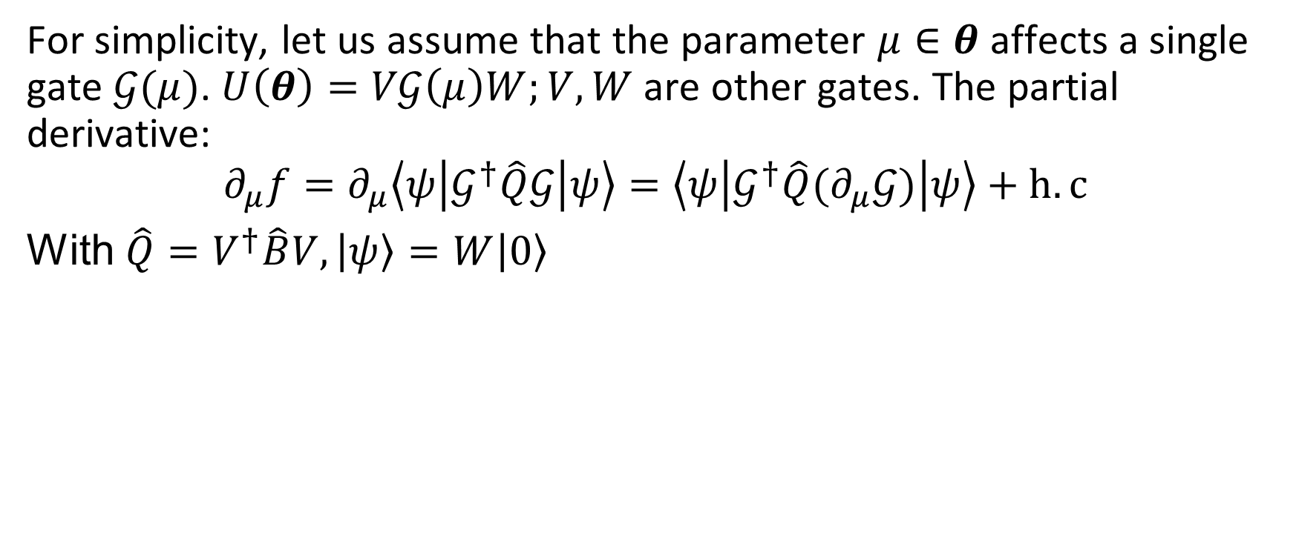
3. Summary
For simplicity, let us assume that the parameter $μ∈θ$ affects a single gate $𝒢(μ)$. $U\left(θ\right)=V𝒢\left(μ\right)W;V,W$ are other gates. The partial derivative:
$$∂_{μ}f=∂_{μ}\left\langle ψ\left|𝒢^{†}\hat{Q}𝒢\right|ψ\right\rangle =\left\langle ψ\left|𝒢^{†}\hat{Q}(∂_{μ}𝒢)\right|ψ\right\rangle +h.c$$
With $\hat{Q}=V^{†}\hat{B}V,\left|ψ\right\rangle =W\left|0\right\rangle$
For more complex $U$, we can use product rule.

Slide 17
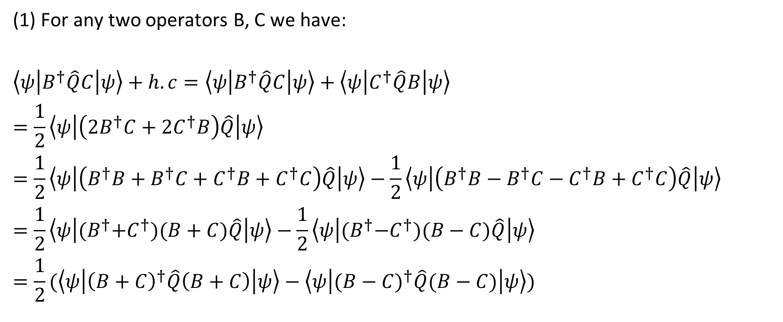
3.1. Proof
(1) For any two operators B, C we have:
$$\left\langle ψ\left|B^{†}\hat{Q}C\right|ψ\right\rangle +h.c=\left\langle ψ\left|B^{†}\hat{Q}C\right|ψ\right\rangle +\left\langle ψ\left|C^{†}\hat{Q}B\right|ψ\right\rangle$$
$$=\frac{1}{2}\left\langle ψ\left|\left(2B^{†}C+2C^{†}B\right)\hat{Q}\right|ψ\right\rangle$$
$$=\frac{1}{2}\left\langle ψ\left|\left(B^{†}B+B^{†}C+C^{†}B+C^{†}C\right)\hat{Q}\right|ψ\right\rangle −\frac{1}{2}\left\langle ψ\left|\left(B^{†}B−B^{†}C−C^{†}B+C^{†}C\right)\hat{Q}\right|ψ\right\rangle$$
$$=\frac{1}{2}\left\langle ψ\left|{(B}^{†}+C^{†})(B+C)\hat{Q}\right|ψ\right\rangle −\frac{1}{2}\left\langle ψ\left|{(B}^{†}−C^{†})(B−C)\hat{Q}\right|ψ\right\rangle$$
$$=\frac{1}{2}(\left\langle ψ\left|{\left(B+C\right)}^{†}\hat{Q}\left(B+C\right)\right|ψ\right\rangle −\left\langle ψ\left|({B−C)}^{†}\hat{Q}(B−C)\right|ψ\right\rangle )$$

Slide 18
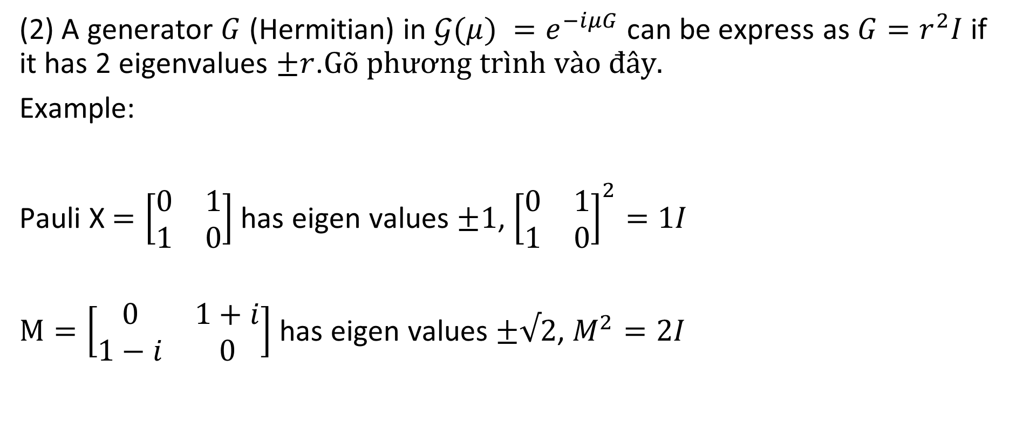
3.1. Proof
(2) A generator $G$ (Hermitian) in $𝒢(μ) =e^{−iμG}$ can be express as ${G=r}^{2}I$ if it has 2 eigenvalues $±r$.
Example:
Pauli X $=\left[\begin{matrix}0 & 1 \\ 1 & 0\end{matrix}\right]$ has eigen values $±1$, ${\left[\begin{matrix}0 & 1 \\ 1 & 0\end{matrix}\right]}^{2}=1I$
$M=\left[\begin{matrix}0 & 1+i \\ 1−i & 0\end{matrix}\right]$ has eigen values $±√2$, $M^{2}=2I$

Slide 19
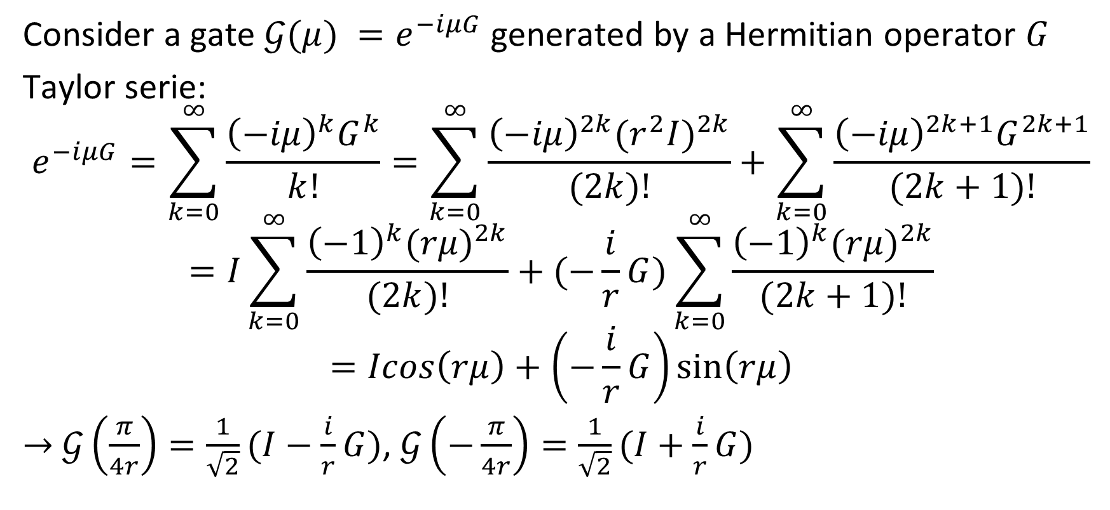
3.1. Proof
Consider a gate $𝒢(μ) =e^{−iμG}$generated by a Hermitian operator $G$
Taylor serie:
$$e^{−iμG}=\sum_{k=0}^{∞}{\frac{{\left(−iμ\right)}^{k}G^{k}}{k!}}=\sum_{k=0}^{∞}{\frac{{\left(−iμ\right)}^{2k}{(r^{2}I)}^{2k}}{(2k)!}+\sum_{k=0}^{∞}{\frac{{\left(−iμ\right)}^{2k+1}G^{2k+1}}{(2k+1)!}}}$$
$$=I\sum_{k=0}^{∞}{\frac{{\left(−1\right)}^{k}{(rμ)}^{2k}}{(2k)!}+(−\frac{i}{r}G)\sum_{k=0}^{∞}{\frac{{\left(−1\right)}^{k}{(rμ)}^{2k}}{(2k+1)!}}}$$
$$=Icos\left(rμ\right)+\left(−\frac{i}{r}G\right)\sin\left(rμ\right)$$
$→$ $𝒢\left(\frac{π}{4r}\right)=\frac{1}{\sqrt{2}}(I−\frac{i}{r}G)$, $𝒢\left(−\frac{π}{4r}\right)=\frac{1}{\sqrt{2}}(I+\frac{i}{r}G)$

Slide 20
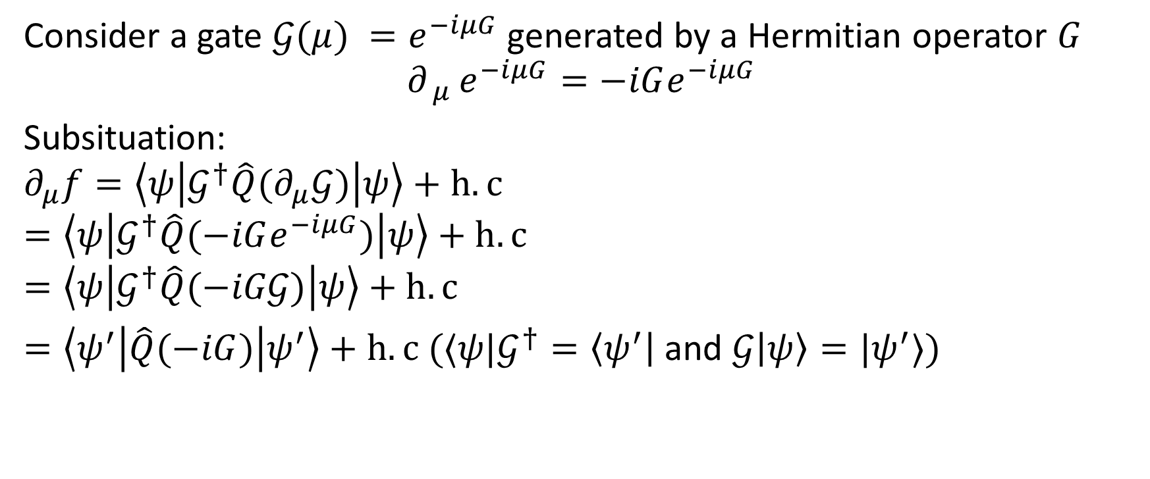

3.2. Summary
Consider a gate $𝒢(μ) =e^{−iμG}$generated by a Hermitian operator $G$
$${∂_{ μ }e}^{−iμG}=−iGe^{−iμG}$$
Subsituation:
$$∂_{μ}f=\left\langle ψ\left|𝒢^{†}\hat{Q}(∂_{μ}𝒢)\right|ψ\right\rangle +h.c$$
$$=\left\langle ψ\left|𝒢^{†}\hat{Q}(−iGe^{−iμG})\right|ψ\right\rangle +h.c$$
$$=\left\langle ψ\left|𝒢^{†}\hat{Q}(−iG𝒢)\right|ψ\right\rangle +h.c$$
$=\left\langle ψ^{′}\left|\hat{Q}(−iG)\right|ψ^{′}\right\rangle +h.c (⟨ψ|𝒢^{†}=\left\langle ψ^{′}\right|$ and $𝒢\left|ψ\right\rangle =|ψ^{′}⟩)$

Slide 21
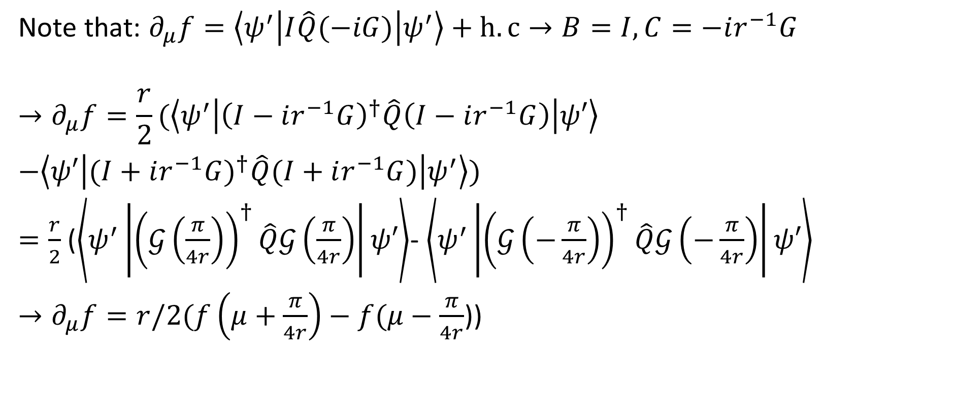
3.2. Summary
Note that: $∂_{μ}f=\left\langle ψ^{′}\left|I\hat{Q}(−iG)\right|ψ^{′}\right\rangle +h.c→B=I, C=−ir^{−1}G$
$$→∂_{μ}f=\frac{r}{2}(\left\langle ψ^{′}\left|{\left(I−ir^{−1}G\right)}^{†}\hat{Q}\left(I−ir^{−1}G\right)\right|ψ′\right\rangle$$
$−\left\langle ψ′\left|({I+ir^{−1}G)}^{†}\hat{Q}(I+ir^{−1}G)\right|ψ^{′}\right\rangle )$
$=\frac{r}{2}$ ($\left\langle ψ^{′}\left|{\left(𝒢\left(\frac{π}{4r}\right)\right)}^{†}\hat{Q}𝒢\left(\frac{π}{4r}\right)\right|ψ′\right\rangle$- $\left\langle ψ^{′}\left|{\left(𝒢\left(−\frac{π}{4r}\right)\right)}^{†}\hat{Q}𝒢\left(−\frac{π}{4r}\right)\right|ψ′\right\rangle$
$→∂_{μ}f=r/2(f\left(μ+\frac{π}{4r}\right)−f(μ−\frac{π}{4r}$))

Slide 22
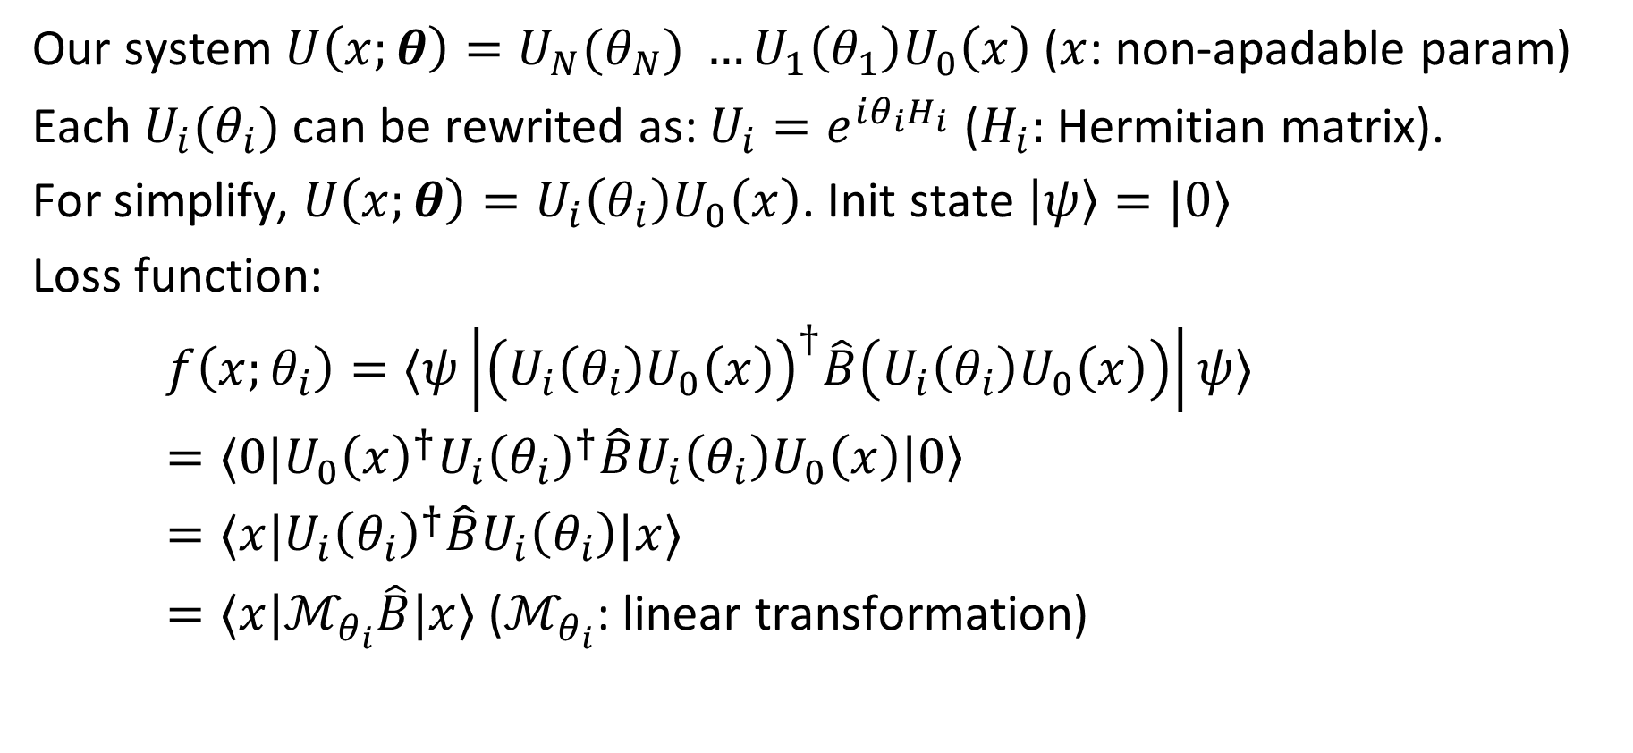
3.2. Summary
Our system $U\left(x;θ\right)=U_{N}(θ_{N}) …{U_{1}\left(θ_{1}\right)U}_{0}\left(x\right)$($x$: non-apadable param)
Each $U_{i}(θ_{i})$ can be rewrited as: $U_{i}=e^{iθ_{i}H_{i}}$ ($H_{i}:$ Hermitian matrix).
For simplify, $U\left(x;θ\right)=U_{i}\left(θ_{i}\right)U_{0}\left(x\right)$. Init state $\left|ψ\right\rangle =|0⟩$
Loss function:
$f\left(x;θ_{i}\right)=⟨ψ\left|{\left(U_{i}\left(θ_{i}\right)U_{0}\left(x\right)\right)}^{†}\hat{B}\left(U_{i}\left(θ_{i}\right)U_{0}\left(x\right)\right)\right|ψ⟩$
$=⟨0|U_{0}{\left(x\right)}^{†}U_{i}{\left(θ_{i}\right)}^{†}\hat{B}U_{i}\left(θ_{i}\right)U_{0}\left(x\right)\left|0\right\rangle$
$=⟨x|U_{i}{\left(θ_{i}\right)}^{†}\hat{B}U_{i}\left(θ_{i}\right)|x⟩$
$=⟨x|ℳ_{θ_{i}}\hat{B}|x⟩$ ($ℳ_{θ_{i}}$: linear transformation)
Notes:
x: input

Slide 23
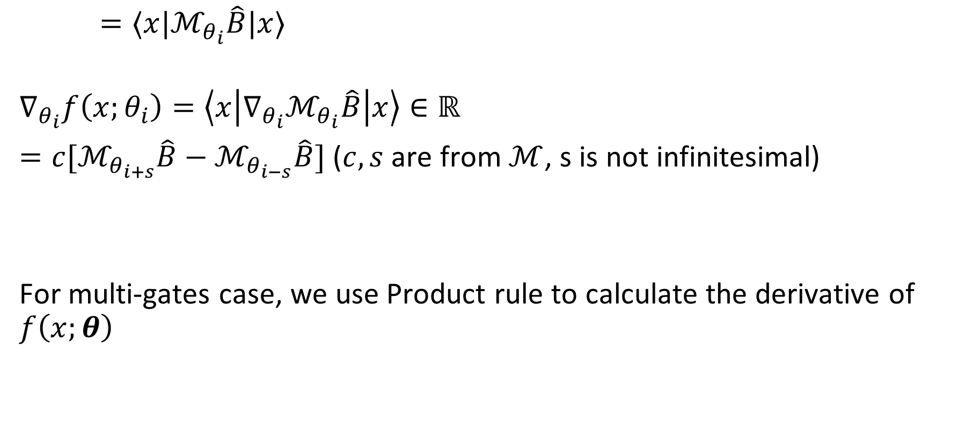
3.2. Summary
$=⟨x|ℳ_{θ_{i}}\hat{B}|x⟩$
$$∇_{θ_{i}}f\left(x;θ_{i}\right)=\left\langle x\left|{∇_{θ_{i}}ℳ}_{θ_{i}}\hat{B}\right|x\right\rangle ∈ℝ$$
$=c[ℳ_{θ_{i+s}}\hat{B}−ℳ_{θ_{i−s}}\hat{B}]$ ($c,s$ are from $ℳ$, s is not infinitesimal)
For multi-gates case, we use Product rule to calculate the derivative of $f\left(x;θ\right)$
Notes:
x: input

Slide 24
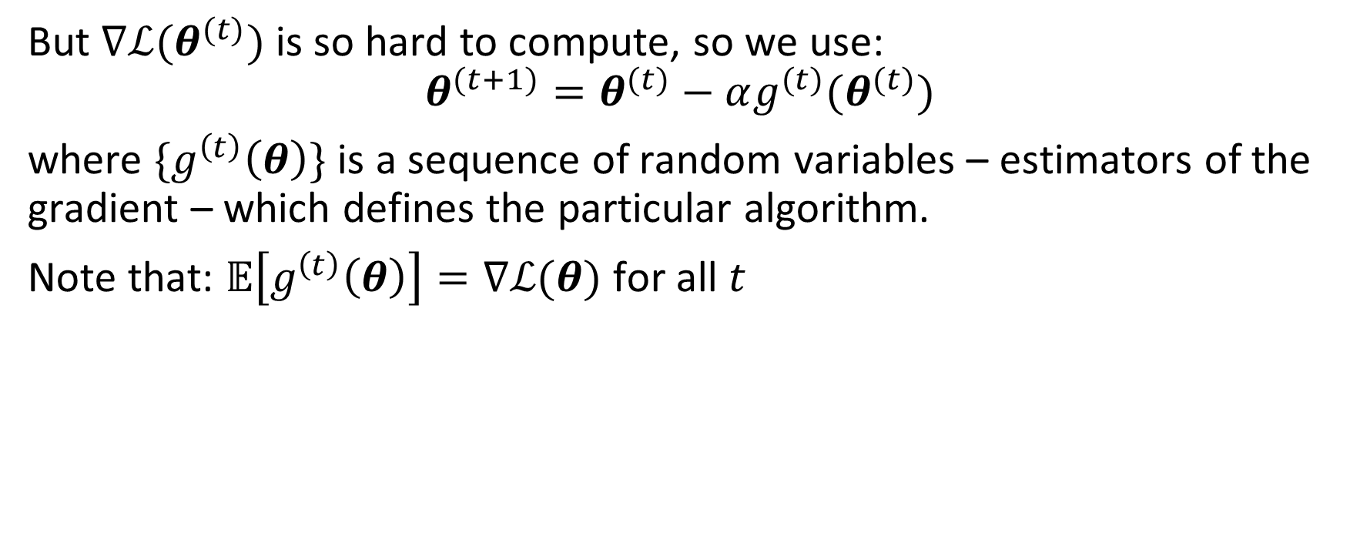
But $∇ℒ(θ^{(t)})$ is so hard to compute, so we use:
$$θ^{(t+1)}=θ^{(t)}−αg^{(t)}(θ^{(t)})$$
where ${\{g}^{\left(t\right)}\left(θ\right)\}$ is a sequence of random variables – estimators of the gradient – which defines the particular algorithm.
Note that: $𝔼\left[g^{\left(t\right)}\left(θ\right)\right]=$ $∇ℒ(θ)$ for all $t$

Slide 25
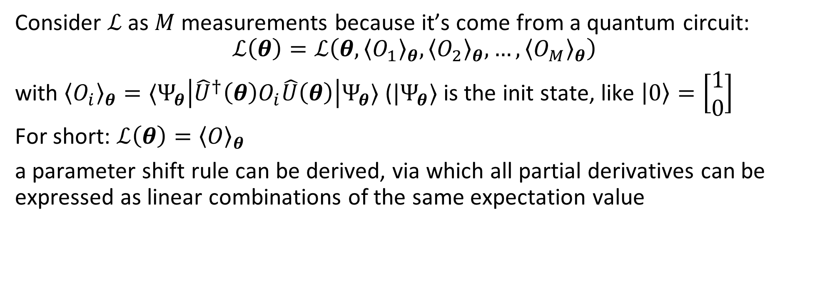
Consider $ℒ$ as $M$ measurements because it’s come from a quantum circuit:
$$ℒ\left(θ\right)=ℒ\left(θ,{\left\langle O_{1}\right\rangle }_{θ},{\left\langle O_{2}\right\rangle }_{θ},…,{\left\langle O_{M}\right\rangle }_{θ}\right)$$
with ${\left\langle O_{i}\right\rangle }_{θ}=⟨Ψ_{θ}\left|{\hat{U}}^{†}\left(θ\right)O_{i}\hat{U}\left(θ\right)\right|Ψ_{θ}⟩$ (${|Ψ}_{θ}⟩$ is the init state, like $\left|0\right\rangle =\left[\begin{matrix}1 \\ 0\end{matrix}\right]$
For short: $ℒ\left(θ\right)={\left\langle O\right\rangle }_{θ}$
a parameter shift rule can be derived, via which all partial derivatives can be expressed as linear combinations of the same expectation value

Slide 26
2. General parameter-shift rule
General parameter-shift rules for quantum gradients, Quantum, volume 6, page 677

Slide 27
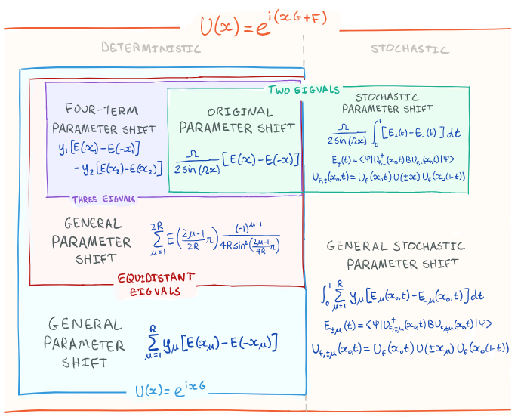

Slide 28
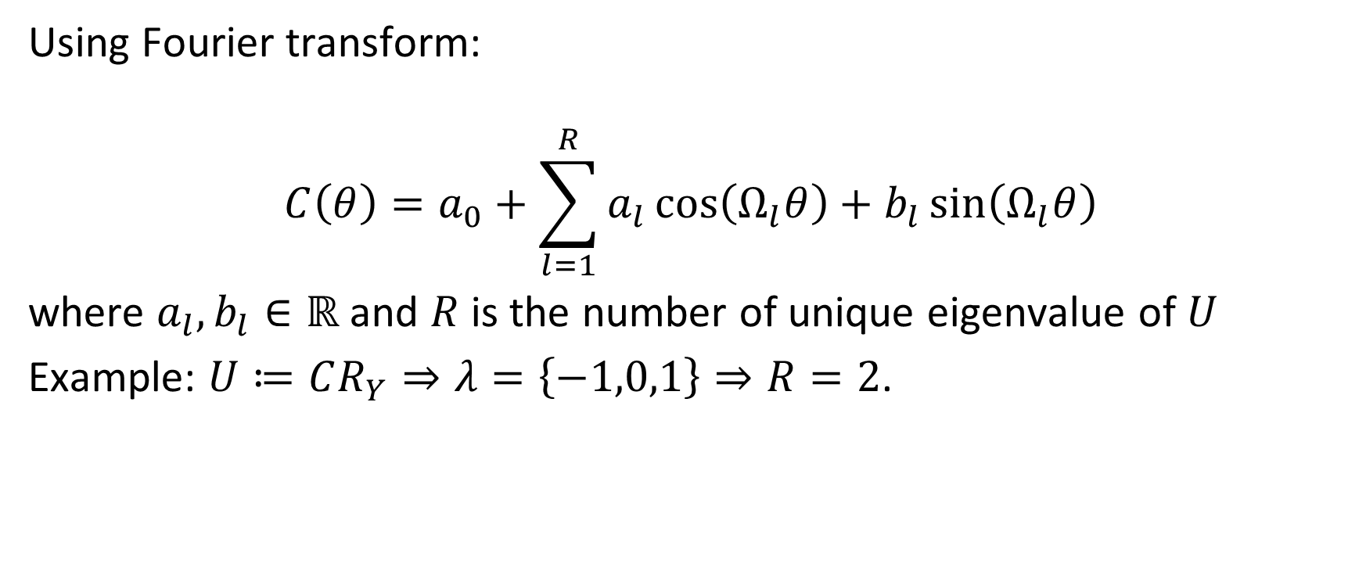
2. General parameter-shift rule
Using Fourier transform:
$$C\left(θ\right)=a_{0}+\sum_{l=1}^{R}{a_{l}\cos\left(Ω_{l}θ\right)+b_{l}\sin\left(Ω_{l}θ\right)}$$
where $a_{l},b_{l}∈ℝ$ and $R$ is the number of unique eigenvalue of $U$
Example: $U≔CR_{Y}⇒λ=\left\{−1,0,1\right\}⇒R=2$.

Slide 29
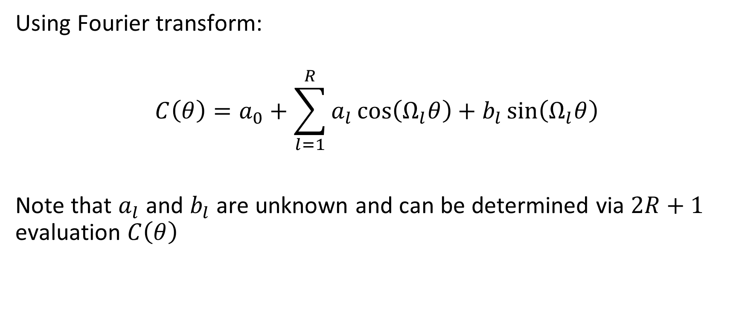
2. General parameter-shift rule
Using Fourier transform:
$$C\left(θ\right)=a_{0}+\sum_{l=1}^{R}{a_{l}\cos\left(Ω_{l}θ\right)+b_{l}\sin\left(Ω_{l}θ\right)}$$
Note that $a_{l}$ and $b_{l}$ are unknown and can be determined via $2R+1$ evaluation $C\left(θ\right)$

Slide 30

2. General parameter-shift rule
$∂C\left(θ\right)=Ω_{l}\sum_{l=1}^{R}{{−a}_{l}\sin\left(Ω_{l}θ\right)+b_{l}\cos\left(Ω_{l}θ\right)}$
Or:
$∂C\left(0\right)=\sum_{μ=1}^{R}{d_{μ}\left(C\left(θ+s_{μ}\right)−C(θ−s_{μ})\right)}$

Slide 31
Quantum natural gradient
James Stokes, Josh Izaac, Nathan Killoran, Giuseppe Carleo
2019

Slide 32
Suppose we have a model parameterized by parameter vector $θ$ that models a distribution $p\left(X | θ\right)$. Our goal is to maximize the log-likelihood $\log{p(X|θ)}$, we defind the score function:
$$s\left(θ\right)=∇log⁡p(X|θ)$$

Slide 33
But the expected value of $s\left(θ\right)=0⇒$ the gradient = 0
Proof:
$$𝔼_{p\left(x | θ\right)}[s\left(θ\right)]=𝔼_{p\left(x | θ\right)}[∇\log{p\left(X | θ\right)}]$$
$$=\int{∇\log{p\left(x | θ\right)}p\left(x | θ\right)dx}$$
$$=\int{\frac{∇p\left(x | θ\right)}{p\left(x | θ\right)}p\left(x | θ\right)dx}$$
$$=∇\int{p\left(x | θ\right)dx=∇1=0}$$
Obviously, the sum of all probs is equals 1

Slide 34
1. Fisher information
Measuring the amount of information that an observable random variable $X$ carries about an unknown parameter $θ$ of a distribution that models $X$.

Slide 35
1. Fisher information
Expected value of the
Square of the
Derivative of the
Log of the
Likelihood of the
Random sample $x_{1},x_{2},…, x_{n}$

Slide 36
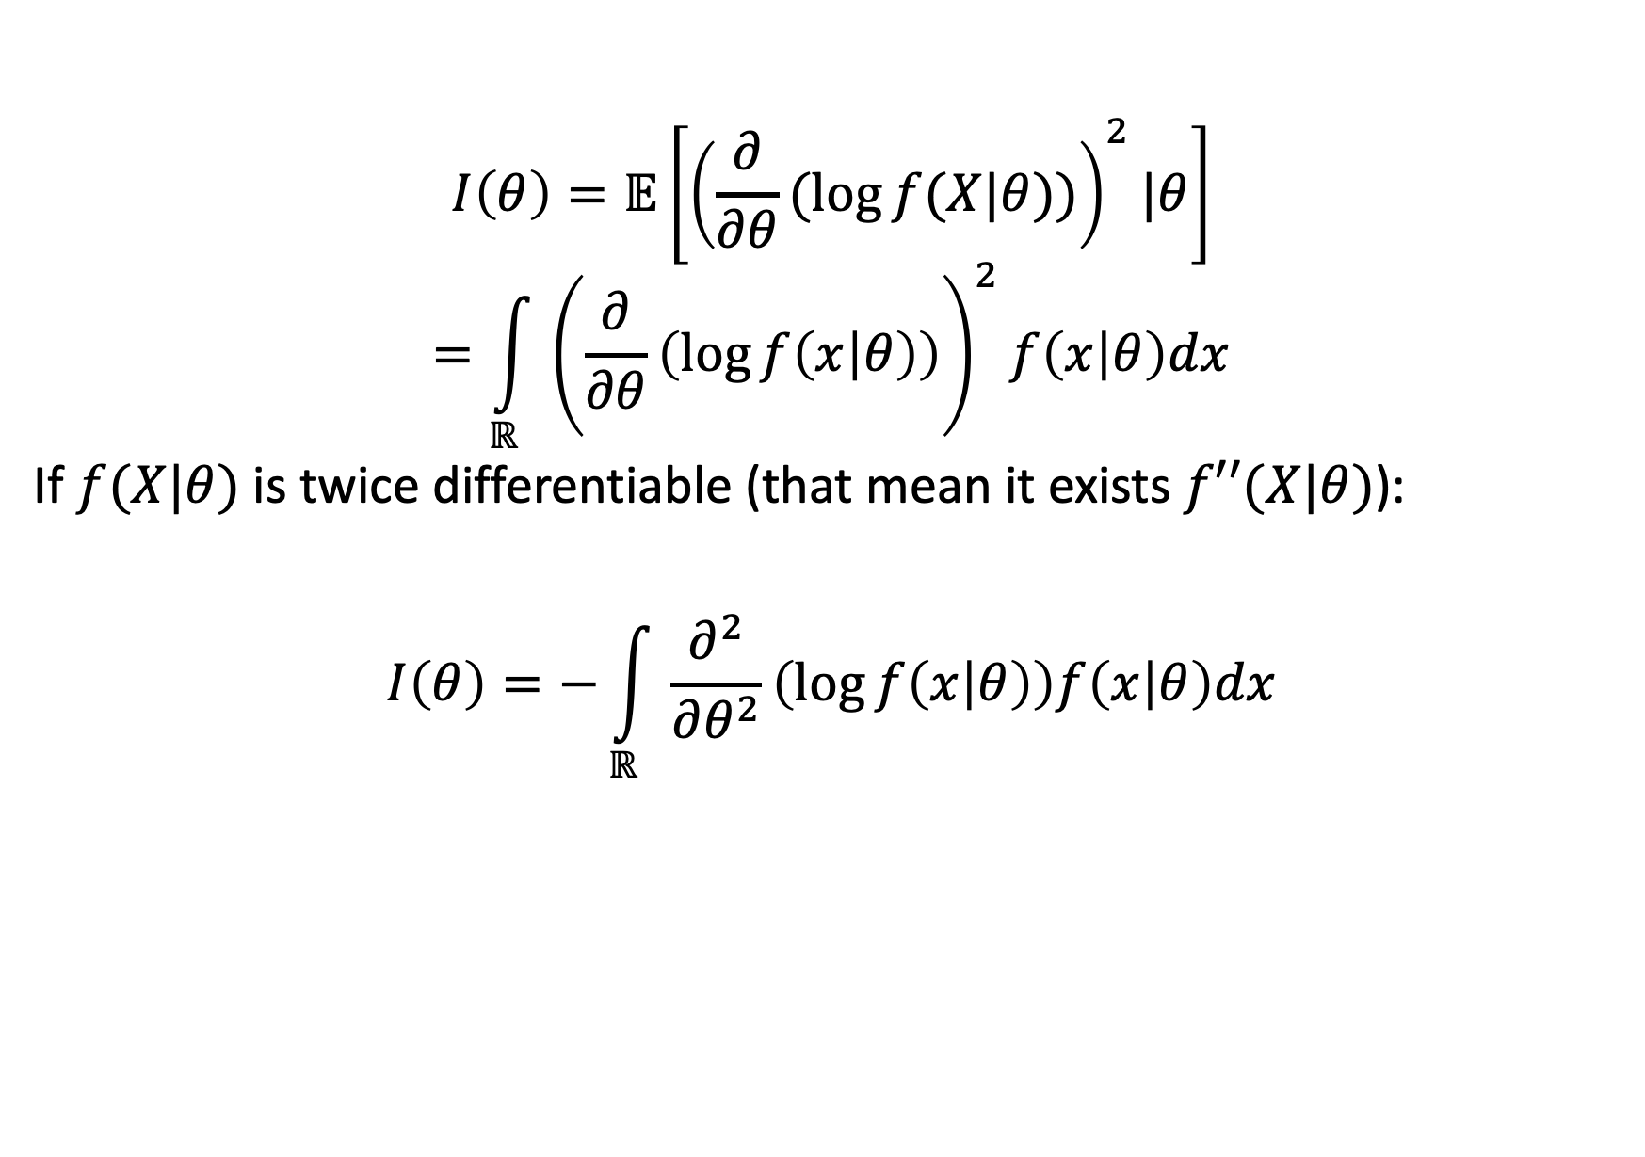
1. Fisher information
$$I\left(θ\right)=𝔼\left[{\left(\frac{∂}{∂θ}(\log{f(X|θ)})\right)}^{2}|θ\right]$$
$$=\int_{ℝ}{{\left(\frac{∂}{∂θ}\left(\log{f\left(x | θ\right)}\right)\right)}^{2}f\left(x | θ\right)dx}$$
If $f(X|θ)$ is twice differentiable (that mean it exists $f′′(X|θ)$):
$$I\left(θ\right)=−\int_{ℝ}{\frac{∂^{2}}{∂θ^{2}}\left(\log{f\left(x | θ\right)}\right)f\left(x | θ\right)dx}$$

Slide 37
1. Fisher information: simple case
Let $X$ be a Bernoulli trial:
$$I\left(θ\right)=𝔼\left[\frac{∂^{2}}{∂θ^{2}}(\log{(θ^{X}{\left(1−θ\right)}^{1−X})}\right]$$
$$=𝔼\left[\frac{∂^{2}}{∂θ^{2}}(\operatorname{Xlog}\left(θ\right)+\left(1−X\right)\log\left(1−θ\right))\right]$$
$$=𝔼\left[\left(\frac{X}{θ^{2}}+\frac{1−X}{{\left(1−θ\right)}^{2}}\right)\right]=𝔼\left[\frac{X}{θ^{2}}\right]+𝔼\left[\frac{1−X}{{\left(1−θ\right)}^{2}}\right]$$

Slide 38
1. Fisher information: simple case
We have:
$$𝔼\left(X\right)=𝔼=θ$$
$$=𝔼\left[\frac{X}{θ^{2}}\right]+𝔼\left[\frac{1−X}{{\left(1−θ\right)}^{2}}\right]=\frac{1}{θ}+\frac{1−θ}{{\left(1−θ\right)}^{2}}=\frac{1−θ+θ}{θ(1−θ)}=\frac{1}{θ(1−θ)}$$

Slide 39
1. Fisher information: matrix form
In case of $θ={\left[\begin{matrix}θ_{1} & θ_{2} & \begin{matrix}… & θ_{N}\end{matrix}\end{matrix}\right]}^{T}$, $I(θ)$ is a $N×N$ matrix:
$$[I{\left(θ\right)]}_{ij}=𝔼\left[\left(\frac{∂}{θ_{i}}\log{f(X|θ)}\right)\left(\frac{∂}{θ_{j}}\log{f(X|θ)}\right)\right]$$

Slide 40
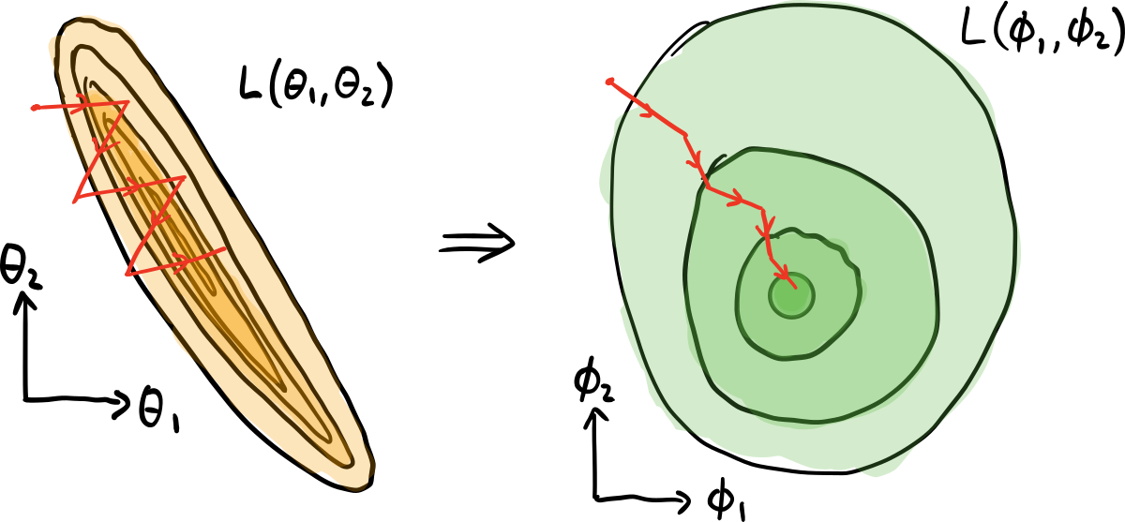
2. Natural gradient descent (NGD)
$$θ^{t+1}=θ^{t}−αF^{−1}\left(θ^{t}\right)∇_{θ}ℒ(θ^{t})$$
With $F$ is the Fisher information matrix.
Notes:
The Fisher information matrix acts as a metric tensor, transforming the steepest descent in the Euclidean parameter space to the steepest descent in the distribution space

Slide 41
2. Natural gradient descent (NGD)
In general, $F$ can be the $N$ Identity matrix with $N=|θ|$, so the NGD formula:
$$θ^{t+1}=θ^{t}−αF^{−1}\left(θ^{t}\right)∇_{θ}ℒ(θ^{t})$$
$$=θ^{t}−αI^{−1}∇_{θ}ℒ(θ^{t})$$
$$=θ^{t}−α∇_{θ}ℒ(θ^{t})$$
turn to SGD formula.
Notes:
The Fisher information matrix acts as a metric tensor, transforming the steepest descent in the Euclidean parameter space to the steepest descent in the distribution space

Slide 42
3. Quantum NGD
Quantum natural gradient optimization technique is proposed in Stokes et al. (2019)
$$F_{ij}=4Re\left[\left\langle ∂_{i}ψ | ∂_{j}ψ\right\rangle −\left\langle ∂_{i}ψ | ψ\right\rangle \left\langle ψ | ∂_{j}ψ\right\rangle \right]$$
Which $|ψ⟩$ is the current state of our system (it’s a $2^{n}$-dimensional vector)

Slide 43
3. Quantum NGD
$$F_{ij}=4Re\left[\left\langle ∂_{i}ψ | ∂_{j}ψ\right\rangle −\left\langle ∂_{i}ψ | ψ\right\rangle \left\langle ψ | ∂_{j}ψ\right\rangle \right]$$
$|∂_{k}ψ⟩$ in quantum circuit can be calculated easy by parameter shift rule:
$$∂_{k}ψ\left(θ\right)=\frac{1}{2}\left(ψ\left(θ_{k}+\frac{π}{2}\right)−ψ\left(θ_{k}−\frac{π}{2}\right)\right)$$
Note that $|∂_{k}ψ⟩$ is also a $2^{n}$ dimensional vector.

Slide 44
3. Quantum NGD
Fact that $F$ is real and Hermitian, so $F_{ij}=F_{ji}$ for all $i,j$
$$θ^{t+1}=θ^{t}−αF^{−1}\left(θ^{t}\right)∇_{θ}ℒ(θ^{t})$$
$$=θ^{t}−αK(θ^{t})$$

Slide 45
3. QNG – Adam or QNG – AdaptBatch, QNG – AdaptLR, …
When mixing QNG with Adam, we treat $K(θ^{t})$ as $∇_{θ}ℒ(θ^{t})$:
$$θ^{t+1}=AdamOptimizer\left(θ^{t},K\left(θ^{t}\right)\right)$$
How about?
$$θ^{t+1}=AdaptBatchOptimizer\left(θ^{t},K\left(θ^{t}\right)\right)$$
$$…$$

Slide 46
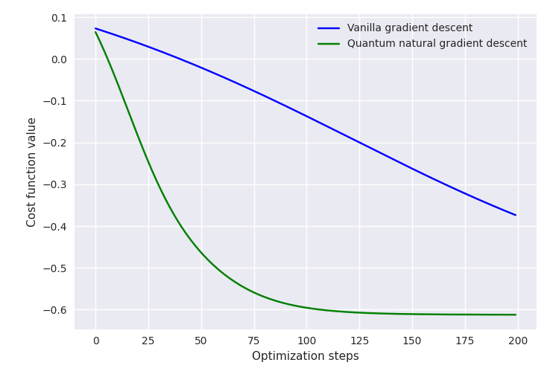
4. Experiments
From penny-lane benchmark

Slide 47
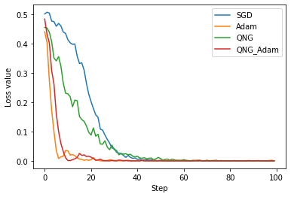
4. Experiments
When optimizing 1-qubit circuit (simplest case)

Slide 48
Fubini-study tensor metric
James Stokes, Josh Izaac, Nathan Killoran, Giuseppe Carleo
2019

Slide 49
1. Intro
In QNG formula, replacing Quantum Fisher information by Fubini-study tensor metric:
$$θ^{t+1}=θ^{t}−αF^{−1}\left(θ^{t}\right)∇_{θ}ℒ(θ^{t})$$
$$→θ^{t+1}=θ^{t}−αg^{†}\left(θ^{t}\right)∇_{θ}ℒ(θ^{t})$$
It can be shown that the Fubini-Study metric tensor reduces to the Fisher information matrix in the classical limit

Slide 50
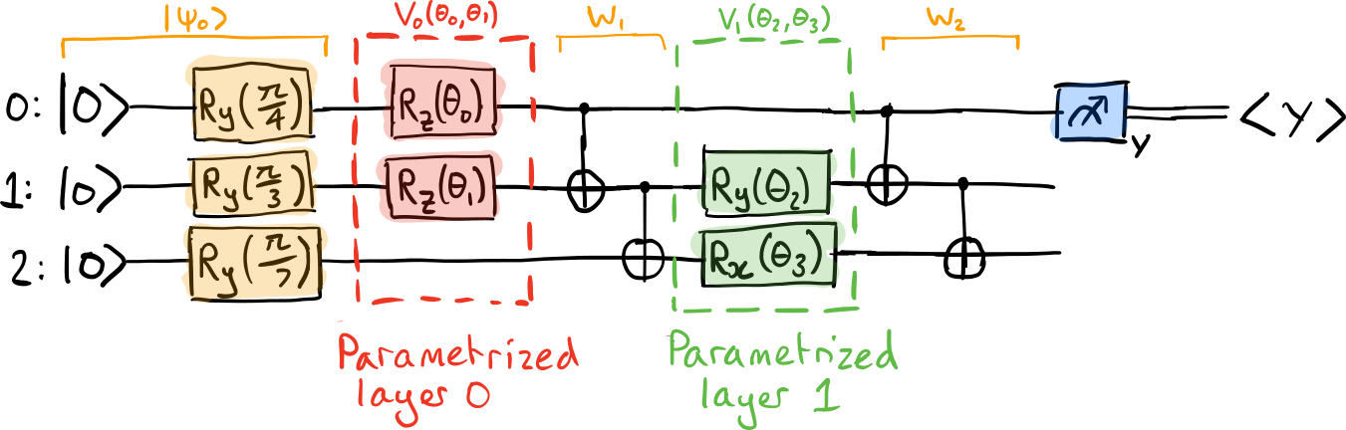
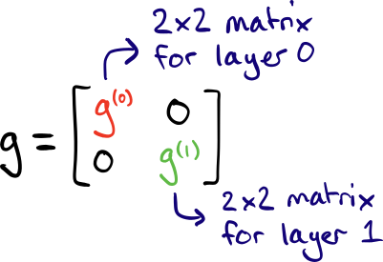
2. Block-diagonal metric tensor
$$g_{ij}^{(l)}=\left\langle ψ_{l−1}\left|K_{i}K_{j}\right|ψ_{l−1}\right\rangle −\left\langle ψ_{l−1}\left|K_{i}\right|ψ_{l−1}\right\rangle \left\langle ψ_{l−1}\left|K_{j}\right|ψ_{l−1}\right\rangle$$
$$|ψ_{1}⟩$$
$$|ψ_{2}⟩$$

Slide 51
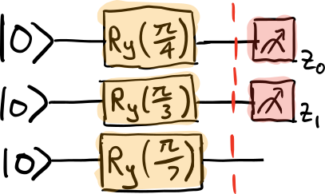
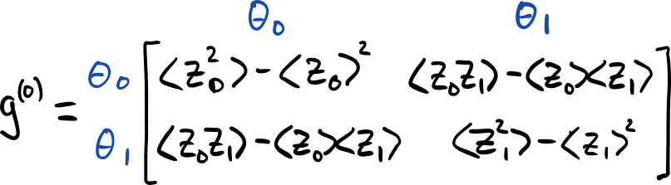
2. Block-diagonal metric tensor

Slide 52
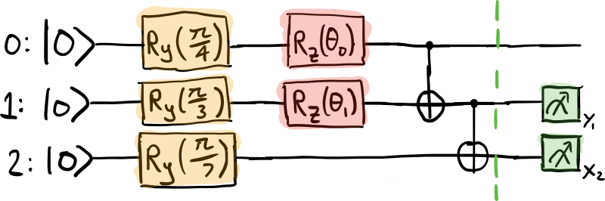
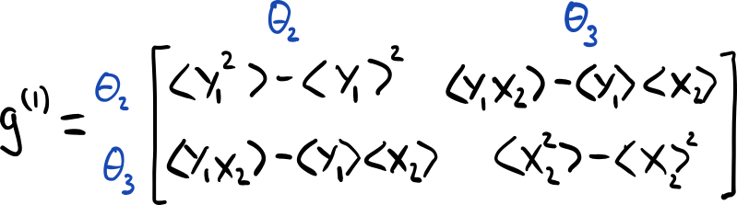
2. Block-diagonal metric tensor

Slide 53
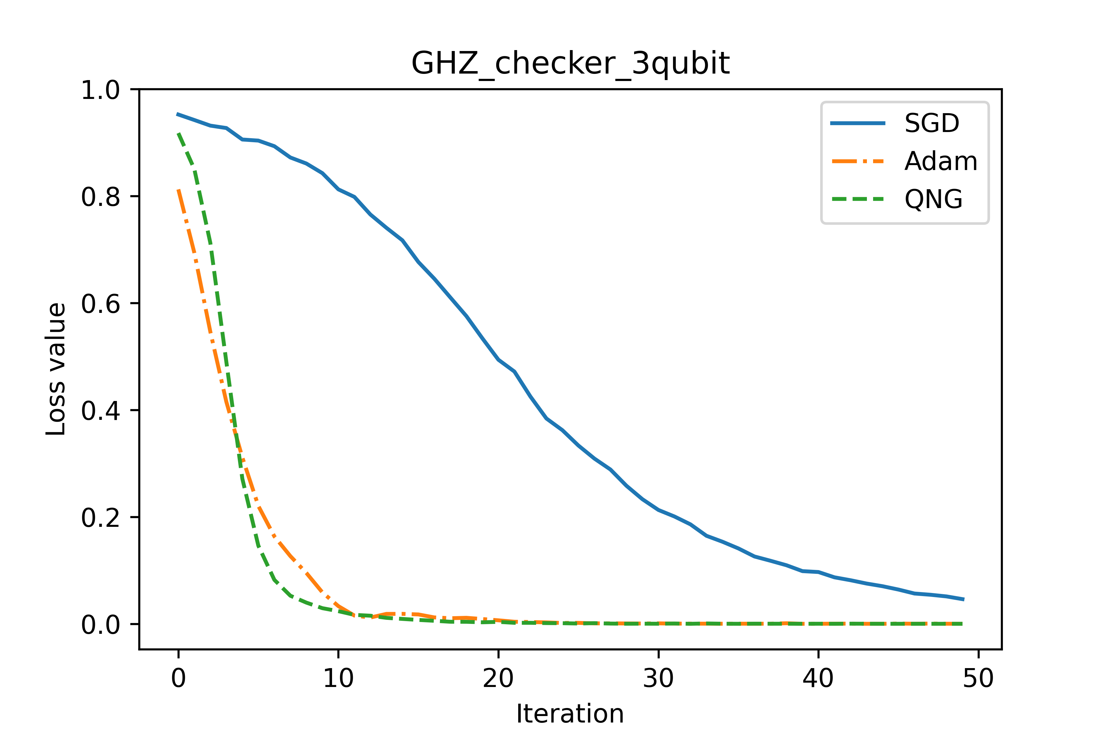
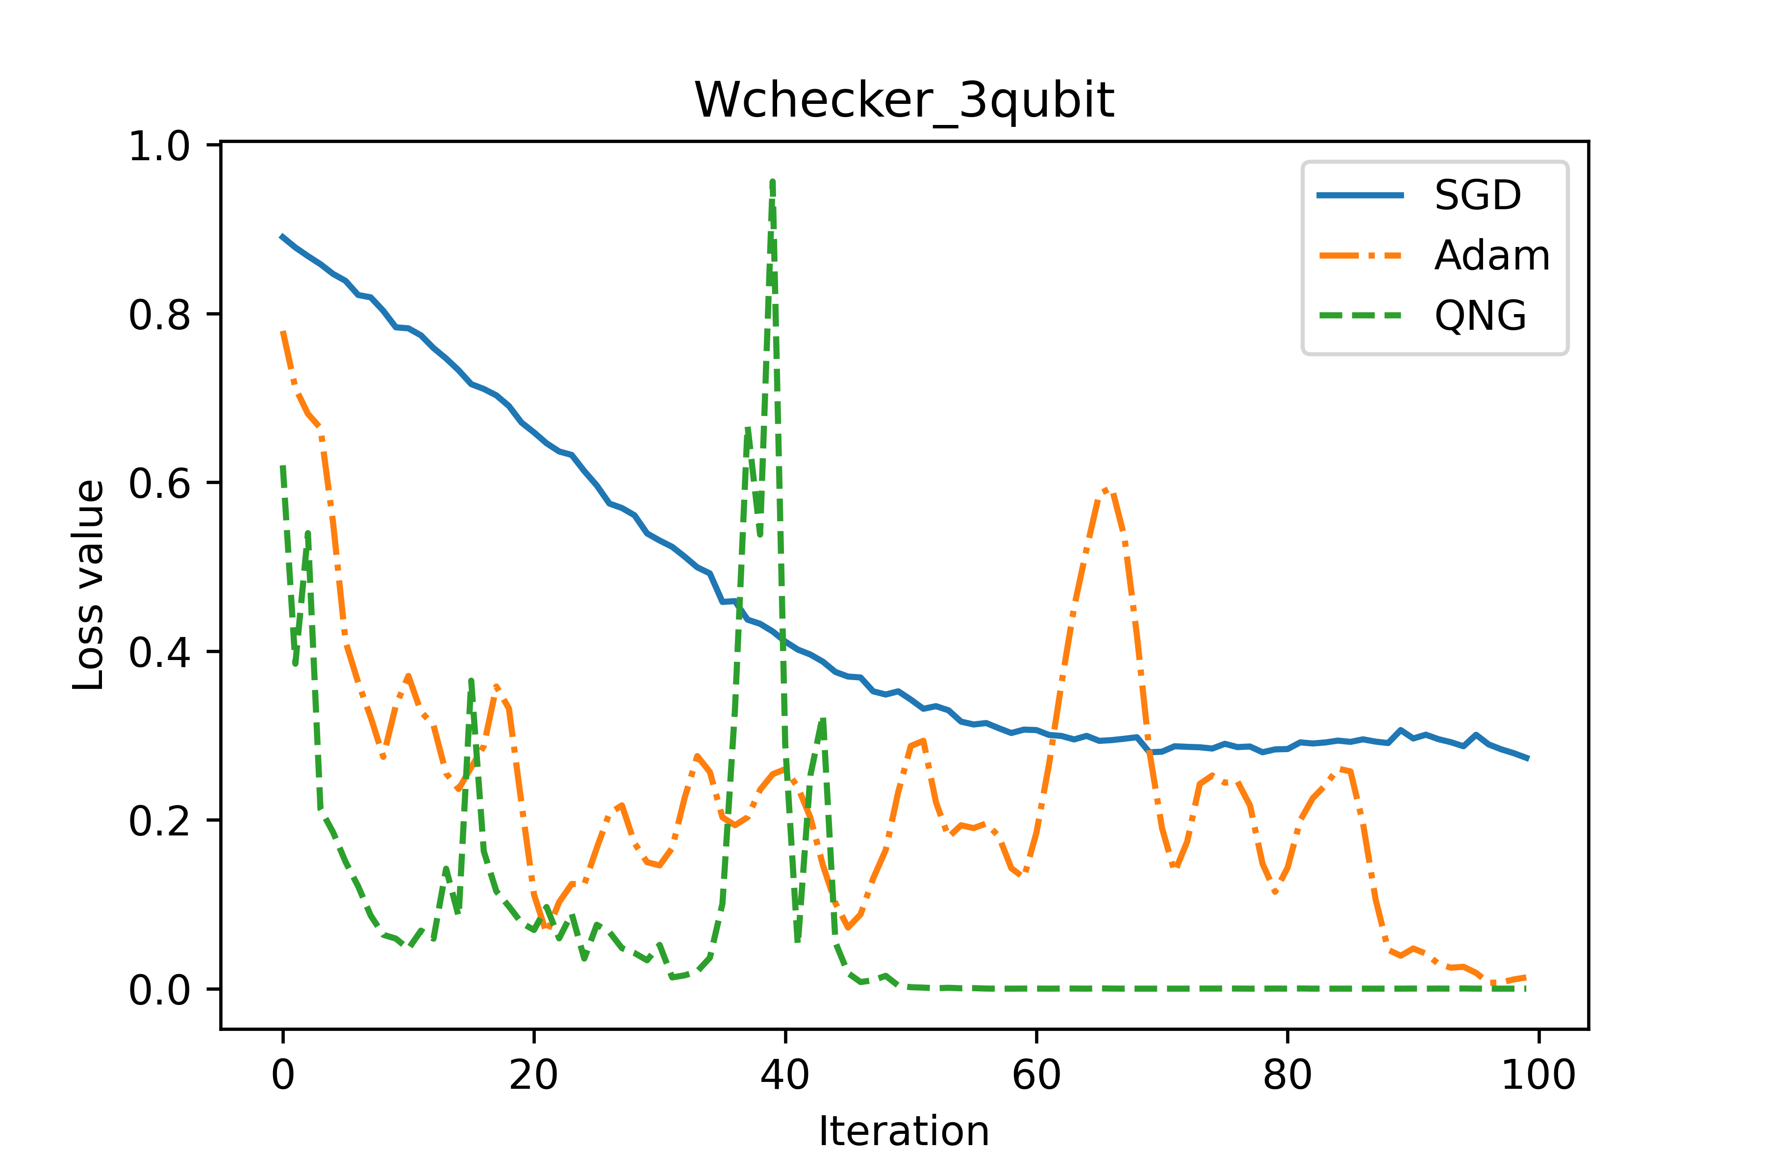
3. Experiments
Through experiments, I see that $\det\left(g\right)≈0 (<{10}^{−10})$ but its inverse $g^{†}$ is good (not explode as Quantum Fisher matrix).

Slide 54

3. Lagrange interpolation (developing)
$$P\left(x\right)=\sum_{i=1}^{n+1}{P\left(x_{i}\right).\prod_{j=1,j≠i}^{n+1}{(\frac{x−x_{j}}{x_{i}−x_{j}})}}$$
$$e^{−ixG}=\sum_{k=0}^{n−1}{e^{−ixλ_{k}}.\prod_{l=0,l≠k}^{n−1}{(\frac{G−λ_{l}I}{λ_{k}−λ_{l}})}}$$

Slide 55
3. Lagrange interpolation (developing)
This approach uses less number of evaluation than general parameter-shift rule in case n = 4 and n = 5.

Slide 56
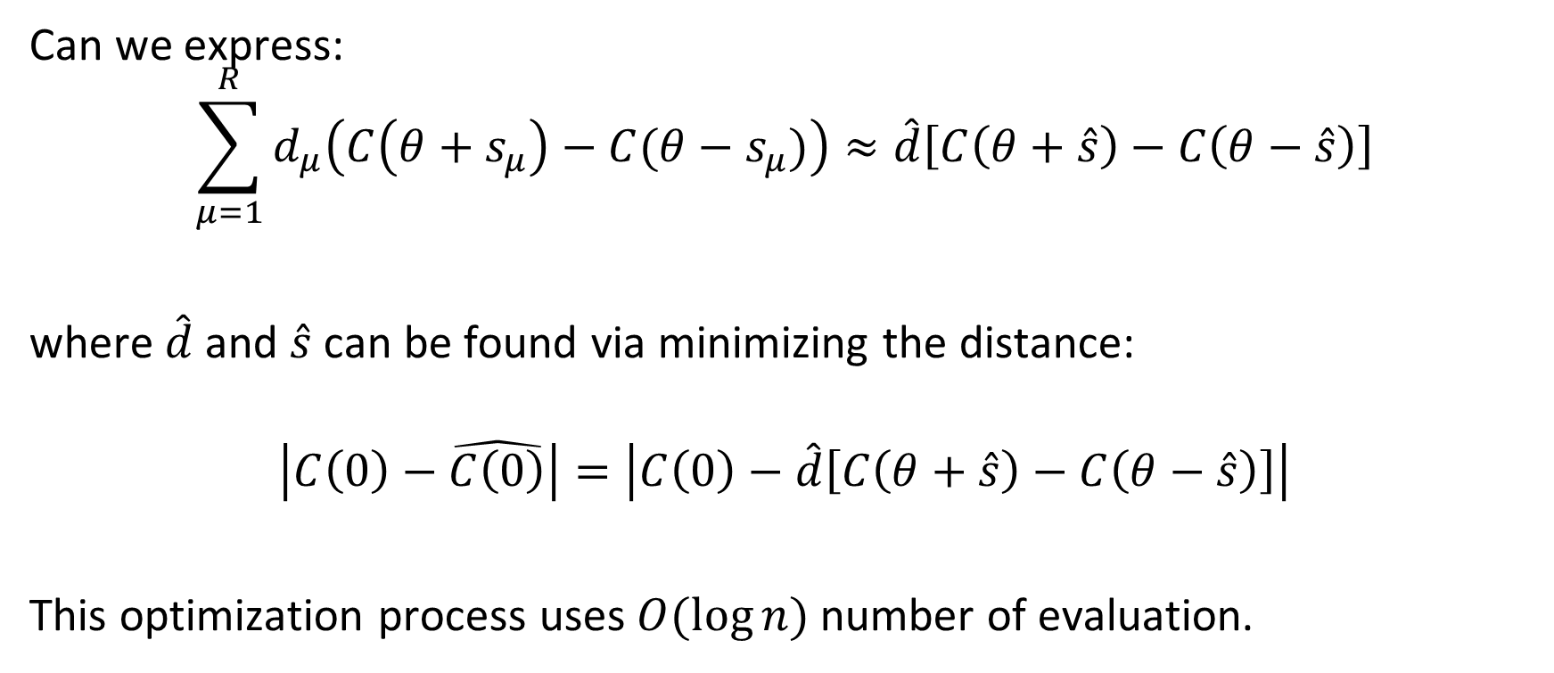
4. Pseudo parameter-shift rule
Can we express:
$$\sum_{μ=1}^{R}{d_{μ}\left(C\left(θ+s_{μ}\right)−C(θ−s_{μ})\right)}≈\hat{d}\left[C\left(θ+\hat{s}\right)−C\left(θ−\hat{s}\right)\right]$$
where $\hat{d}$and $\hat{s}$ can be found via minimizing the distance:
$$\left|C\left(0\right)−\hat{C\left(0\right)}\right|=\left|C\left(0\right)−\hat{d}\left[C\left(θ+\hat{s}\right)−C\left(θ−\hat{s}\right)\right]\right|$$
This optimization process uses $O(\log{n})$ number of evaluation.

Slide 57
Parameter shift in neural net
3/7/2021

Slide 58

1. Intro
Assume: $f\left(x\right)=x^{2}+cos⁡(x+2)$
We can calculate $f^{′}\left(x\right)=r(f\left(x+ε\right)−f\left(x−ε\right))$ $(1)$ directly.
But what values of $r$ and $ε$? Is it exist?

Slide 59

2. Experiments
Assume $r∈\left(−10,10\right),ε∈(−5,5)$, substitute $r_{i},ε_{i}$ into the equation (1) and calculate loss $|f^{′}\left(x\right)−\hat{f′(x)}|$

Slide 60


2. Experiments
With the smallest share $Δr≈0.5, Δ≈0.3$.
$$loss_{min}=0.00x$$

Slide 61


2. Experiments
With the smallest share $Δr≈0.05, Δ≈0.03$.
$$loss_{min}=0.000x$$

Slide 62

2. Experiments
With the smallest share $Δr≈0.005, Δ≈0.003$.
$$loss_{min}≈10e^{−7}$$

Slide 63


3. Guess
For any differentiable function $f$, exist some $r$ and $ε$ satisfy (1).
- Cyclicity: high oppoturnity to find $r, ε$

Slide 64



3. Guess
Independent from $x$
$⇒$ Cyclicity
Ex1: $f\left(x\right)=sin⁡x$
Solve eq: $r\left(f\left(x+ε\right)−f\left(x−ε\right)\right)=\sin{′x}=cos⁡x$
$⇒2rcos\left(x\right)sin\left(ε\right)=\cos{x}$
$⇒2r\sin{ε}=1$
Ex2: $f\left(x\right)=\cos\left(x+π\right)\cos\left(x+\frac{π}{2}\right),f^{′}\left(x\right)=−\sin^{2}{x}+\cos^{2}x=cos(2x)$
Solve eq: $r(\cos\left(x+π+ε\right)\cos\left(x+\frac{π}{2}+ε\right)−\cos\left(x+π−ε\right)\cos{(x+\frac{π}{2}−ε)})$
$=\frac{1}{2}r(\cos\left(2x+2ε+\frac{3}{2}π\right)+\cos\left(\frac{π}{2}\right)−\cos\left(2x−2ε+\frac{3}{2}π\right)−cos⁡(\frac{π}{2}))$
$=−r\sin\left(2x+\frac{3}{2}π\right)\sin\left(2ε\right)=rcos\left(2x\right)\sin\left(2ε\right)=\cos\left(2x\right)⇒rsin\left(2ε\right)=1$

Slide 65




3. Guess
Non cyclicity: if $f$ is not differentiable at some points
$$\frac{\left(x^{2}+3x−1\right)}{(x+1)}$$

Slide 66




3. Guess
Singularity: if $f$ is not differentiable at some points
$$ln⁡(x)$$

Slide 67


3. Guess
Dependent on $x$
$⇒$ Non cyclicity
Ex3: $f\left(x\right)=x^{2}+cos⁡(x+2)$, $f^{′}\left(x\right)=2x−sin⁡(x+2)$
Solve eq: $r\left({\left(x+ε\right)}^{2}+\cos\left(x+2+ε\right)−{\left(x−ε\right)}^{2}−\cos\left(x+2−ε\right)\right)=2x−sin⁡(x+2)$
$⇒r(4xε−2\sin\left(x+2\right)\sin\left(ε\right)=2x−sin⁡(x+2)$
$⇒4xrε−2x=sin⁡(x+2)(2\sin{ε}−1)$
$⇒\frac{2rε−1}{2\sin{ε}−1}=\frac{\sin\left(x+2\right)}{2x}$

Slide 68


3. Guess
Dependent on $x$
$⇒$ Non cyclicity
Ex4: $f\left(x\right)=\ln\left(x\right),f^{′}\left(x\right)=\frac{1}{x}$
Solve eq: $r\left(\ln\left(x+ε\right)−\ln\left(x−ε\right)\right)=\frac{1}{x}$
Taylor series:
$$\ln\left(x+ε\right)=\ln\left(x\right)+\frac{1}{x}ε−\frac{1}{2!\left(x^{2}\right)}ε^{2}+…+O(ε^{2})$$
$$\ln\left(x−ε\right)=\ln\left(x\right)+\frac{1}{x}(−ε)−\frac{1}{2!\left(x^{2}\right)}ε^{2}+…+O(ε^{2})$$
$$⇒r\left(\frac{2ε}{x}\right)+O\left(ε^{2}\right)=\frac{1}{x}⇒2rε≈1$$

Slide 69







4. In neural net
1
Ex5: Simplest net without activation function
$f\left(w_{1},w_{2},b\right)=w_{1}x_{1}+w_{2}x_{2}+b$
$∇f≜\left[\begin{matrix}\frac{∂f}{w_{1}} & \frac{∂f}{w_{2}} & \frac{∂f}{b}\end{matrix}\right]=[\begin{matrix}x_{1} & x_{2} & 1\end{matrix}]$ (1)
$$b$$
$$x_{1}$$
$$w_{1}$$
+,*
$$f$$
$$x_{2}$$
$$w_{2}$$

Slide 70

4. In neural net
Apply parameter shift:
$∇f≜r[\begin{matrix}(f\left(w_{1}+ε,w_{2},b\right)−f(w_{1}−ε,w_{2},b)) & … & …\end{matrix}]$
$r\left(f\left(w_{1}+ε,w_{2},b\right)−f\left(w_{1}−ε,w_{2},b\right)\right)=r\left(\left(\left(w_{1}+ε\right)x_{1}+w_{2}x_{2}+b\right)−\left(\left(w_{1}−ε\right)x_{1}+w_{2}x_{2}+b\right)\right)=2rεx_{1}=x_{1}$ (follow (1)) $⇒2rε=1$
Similar with $x_{2}.$
$r\left(f\left(w_{1},w_{2},b+ε\right)−f\left(w_{1},w_{2},b−ε\right)\right)=r\left(\left(w_{1}x_{1}+w_{2}x_{2}+b+ε\right)−\left(w_{1}x_{1}+w_{2}x_{2}+b−ε\right)\right)=2rε=1$ (follow (1))

Slide 71










4. In neural net
1
Ex5: Simplest net with sigmod function
$g\left(w_{1},w_{2},b\right)=σ\left(w_{1}x_{1}+w_{2}x_{2}+b\right)$
$=σ(f\left(w_{1},w_{2},b\right))$
$∇g≜\left[\begin{matrix}\frac{∂f}{w_{1}} & \frac{∂f}{w_{2}} & \frac{∂f}{b}\end{matrix}\right]$
$=σ(w_{1},w_{2},b)(1−σ(w_{1},w_{2},b))[\begin{matrix}x_{1} & x_{2} & 1\end{matrix}]$ (2)
$$b$$
$$x_{1}$$
$$w_{1}$$
+,*
$$σ$$
$$…$$
$$x_{n}$$
$$w_{n}$$
$$f(w,b)$$
$$g(w,b)$$

Slide 72


4. In neural net
Apply parameter shift:
$∇g≜r[\begin{matrix}(f\left(w_{1}+ε,w_{2},b\right)−f(w_{1}−ε,w_{2},b)) & … & …\end{matrix}]$
$r\left(f\left(w_{1}+ε,w_{2},b\right)−f\left(w_{1}−ε,w_{2},b\right)\right)$
$=r\left(σ\left({(w}_{1}+ε\right)x_{1}+w_{2}x_{2}+b\right)−σ({(w}_{1}−ε)x_{1}+w_{2}x_{2}+b))$
$=r\left(\frac{e^{f\left(w,b\right)}e^{{εx}_{1}}}{1+e^{f\left(w,b\right)}e^{{εx}_{1}}}−\frac{e^{f\left(w,b\right)}e^{−{εx}_{1}}}{1+e^{f\left(w,b\right)}e^{{−εx}_{1}}}\right)=\frac{x_{1}e^{f\left(w,b\right)}}{{\left(1+e^{f\left(w,b\right)}\right)}^{2}}$
$⇔r\left(\frac{e^{{εx}_{1}}}{1+e^{f\left(w,b\right)}e^{{εx}_{1}}}−\frac{1}{e^{{εx}_{1}}+e^{f\left(w,b\right)}}\right)=\frac{x_{1}}{{\left(1+e^{f\left(w,b\right)}\right)}^{2}}$

Slide 73

4. In neural net
$⇔r\left(\frac{e^{{εx}_{1}}}{1+e^{f}e^{{εx}_{1}}}−\frac{1}{e^{{εx}_{1}}+e^{f}}\right)=\frac{x_{1}}{{\left(1+e^{f}\right)}^{2}}$
$⇔r(\frac{e^{2εx_{1}}−1}{(1+e^{f}e^{{εx}_{1}})(e^{{εx}_{1}}+e^{f})})=\frac{x_{1}}{{\left(1+e^{f}\right)}^{2}}$ . Assume $x_{1}>0$
$⇔\ln\left(r\right)+\ln\left(e^{2εx_{1}}−1\right)−\ln\left(1+e^{f}e^{{εx}_{1}}\right)−\ln\left(e^{{εx}_{1}}+e^{f}\right)=\ln\left(x_{1}\right)−2ln⁡(1+e^{f})$
$$⇔ln\left(r\right)+2εx_{1}−\left(f+εx_{1}\right)−εx_{1}−f−iπ≈\ln\left(x_{1}\right)−2f$$
$$⇔ln\left(r\right)−iπ=ln⁡(x_{1})$$

